Slide 1

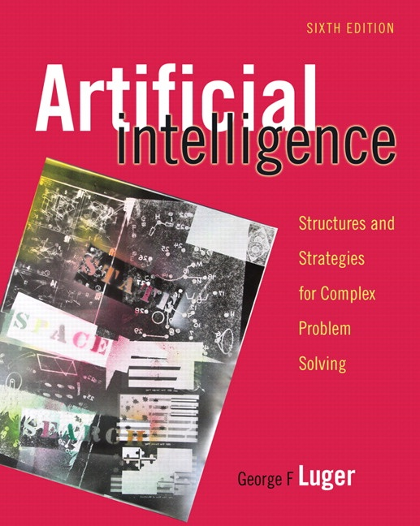
Knowledge Representation
7.0 Issues in Knowledge Representation
7.1 A Brief History of AI Representational Systems
7.2 Conceptual Graphs: A Network
Language
7.3 Alternatives to Explicit Representation
7.4 Agent Based and Distributed Problem Solving
7.5 Epilogue and References
7.6 Exercises
George F Luger
ARTIFICIAL INTELLIGENCE 6th edition
Structures and Strategies for Complex Problem Solving
Luger: Artificial Intelligence, 6th edition. © Pearson Education Limited, 2009

Slide 2
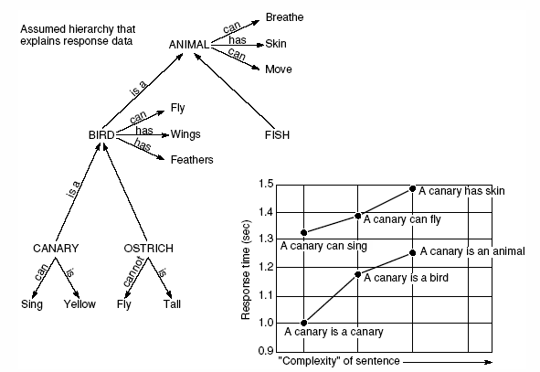
Fig 7.1 Semantic network developed by Collins and Quillian in their research on human information storage and response times (Harmon and King, 1985)
Luger: Artificial Intelligence, 6th edition. © Pearson Education Limited, 2009

Slide 3
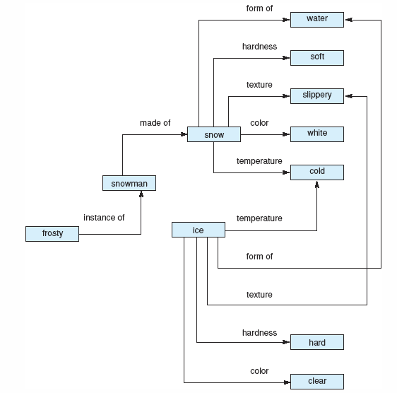
Fig 7.2 Network representation of properties of snow and ice
Luger: Artificial Intelligence, 6th edition. © Pearson Education Limited, 2009

Slide 4
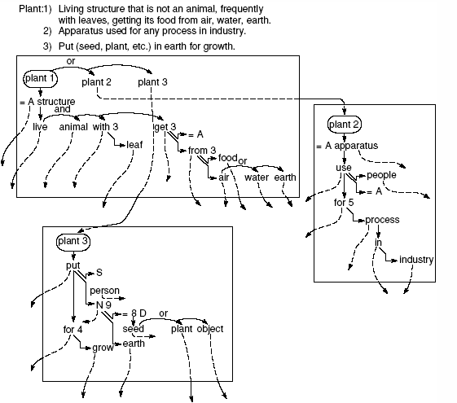
Fig 7.3 three planes representing three definitions of the word “plant” (Quillian, 1967).
Luger: Artificial Intelligence, 6th edition. © Pearson Education Limited, 2009

Slide 5
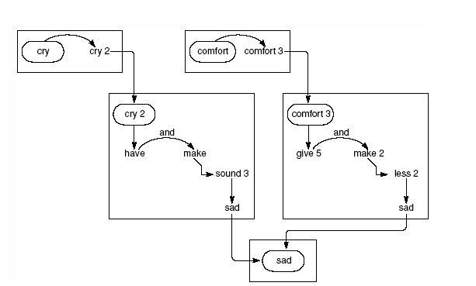
Fig 7.4 Intersection path between “cry” and “comfort” (Quillian 1967).
Luger: Artificial Intelligence, 6th edition. © Pearson Education Limited, 2009

Slide 6
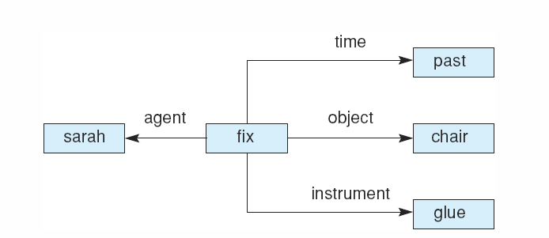
Fig 7.5 Case frame representation of the sentence “Sarah fixed the chair with glue.”
Luger: Artificial Intelligence, 6th edition. © Pearson Education Limited, 2009

Slide 7
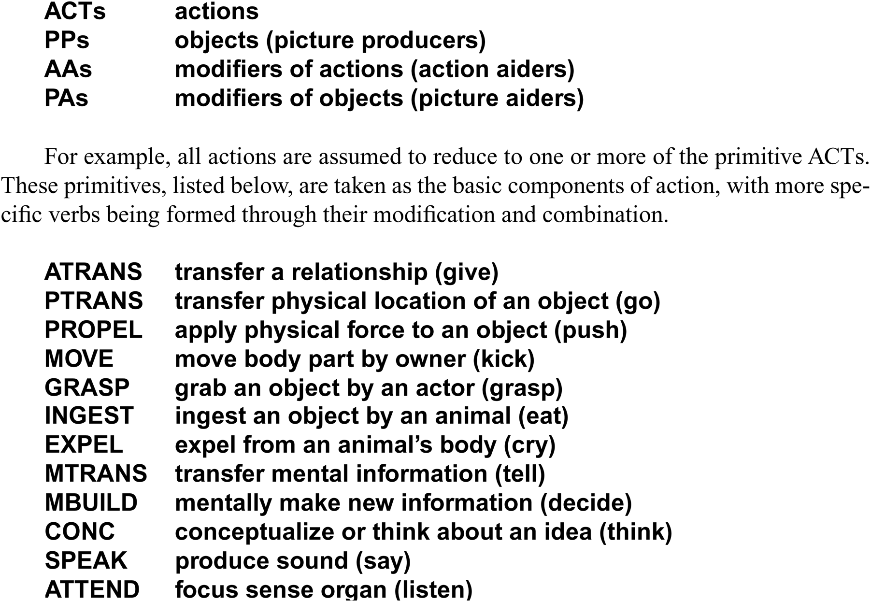
Conceptual dependency theory of four primitive conceptualizations
Luger: Artificial Intelligence, 6th edition. © Pearson Education Limited, 2009

Slide 8
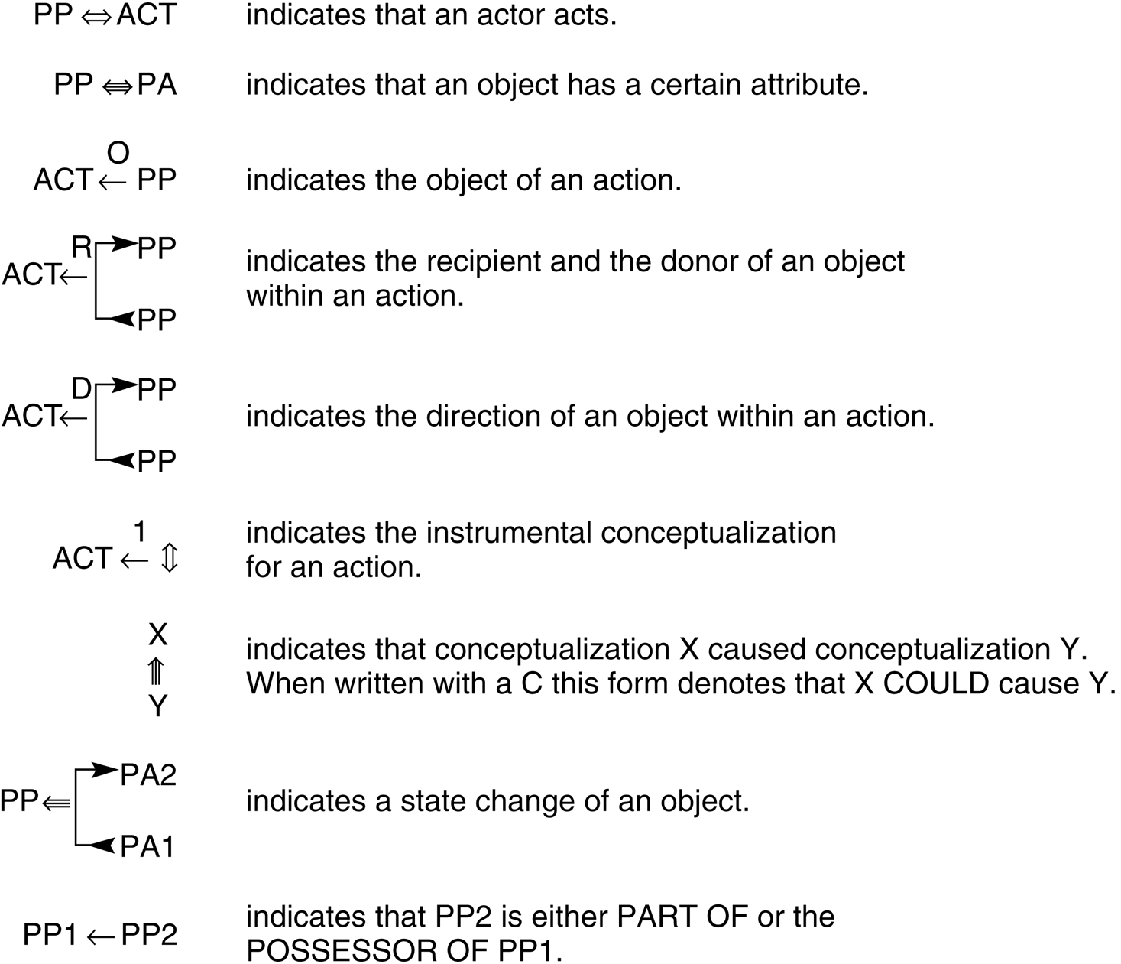
Fig 7.6 Conceptual dependencies (Schank and Rieger, 1974).
Luger: Artificial Intelligence, 6th edition. © Pearson Education Limited, 2009

Slide 9
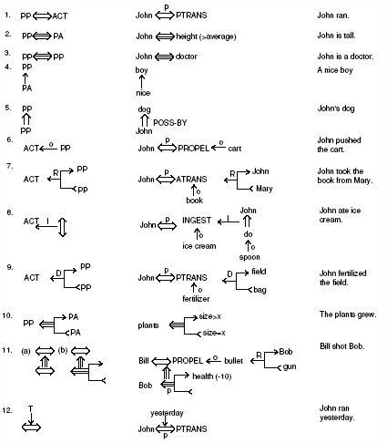
Fig 7.8 Some bacis conceptual dependencies and their use in representing more complex English sentences, adapted from Schank and Colby (1973).
Luger: Artificial Intelligence, 6th edition. © Pearson Education Limited, 2009

Slide 10
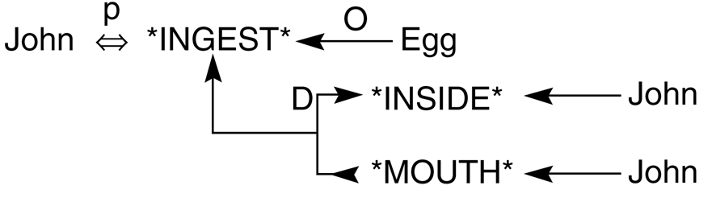
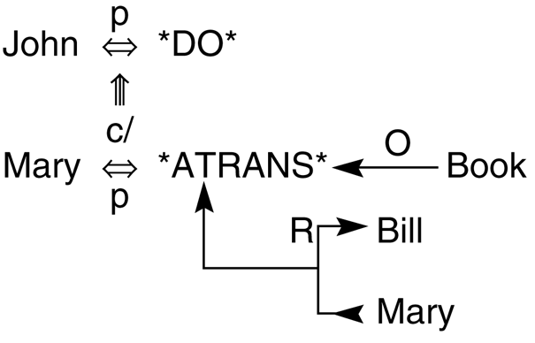
Fig 7.9 Conceptual dependency representing “John ate the egg”
(Schank and Rieger 1974).
Fig 7.10 Conceptual dependency representation of the sentence “John prevented Mary from giving a book to Bill” (Schank and Rieger 1974).
Luger: Artificial Intelligence, 6th edition. © Pearson Education Limited, 2009

Slide 11
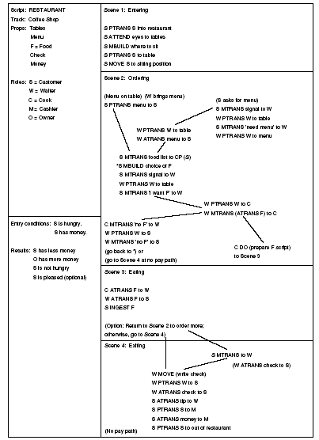
Fig 7.11 a restaurant script (Schank and Abelson, 1977).
Luger: Artificial Intelligence, 6th edition. © Pearson Education Limited, 2009

Slide 12
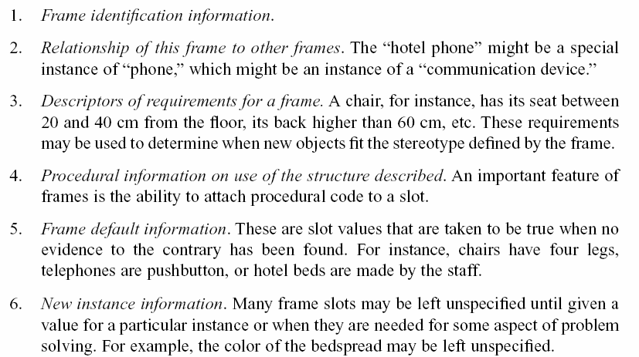
A frame includes:
Luger: Artificial Intelligence, 6th edition. © Pearson Education Limited, 2009

Slide 13
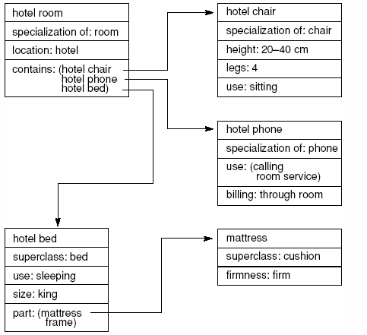
Fig 7.12 Part of a frame description of a hotel room. “Specialization” indicates a pointer to a superclass.
Luger: Artificial Intelligence, 6th edition. © Pearson Education Limited, 2009

Slide 14
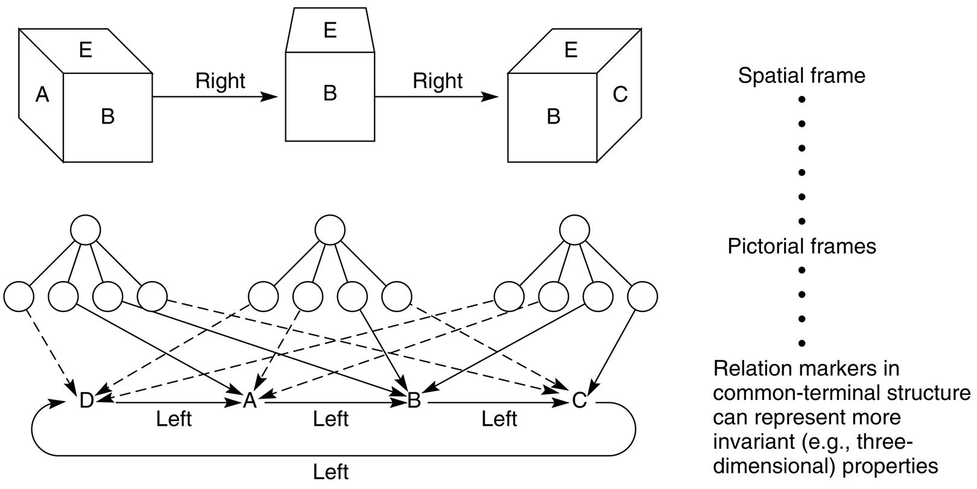
Fig 7.13 Spatial frame for viewing a cube (Minsky, 1975).
Luger: Artificial Intelligence, 6th edition. © Pearson Education Limited, 2009

Slide 15
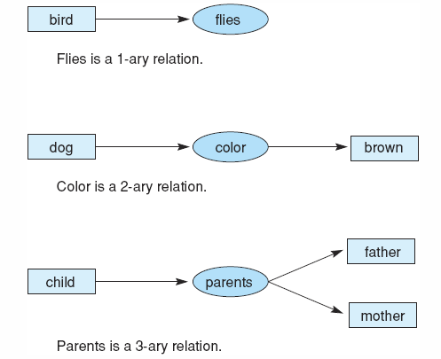
Fig 7.14 Conceptual relations of different arities.
Luger: Artificial Intelligence, 6th edition. © Pearson Education Limited, 2009

Slide 16
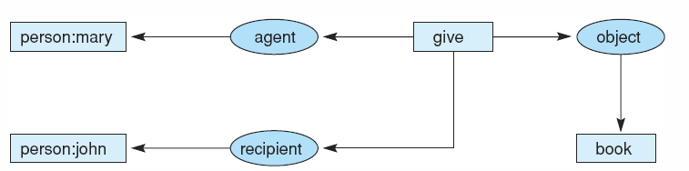
Fig 7.15 Graph of “Mary gave John the book.”
Luger: Artificial Intelligence, 6th edition. © Pearson Education Limited, 2009

Slide 17
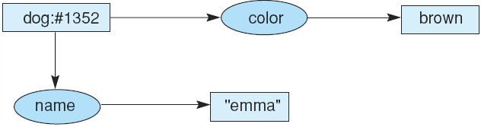
Fig 7.16 Conceptual graph indicating that the dog named Emma is brown.
Fig 7.17 Conceptual graph indicating that a particular (but unnamed) dog is brown.
Fig 7.18 Conceptual graph indicating that a dog named Emma is brown.
Luger: Artificial Intelligence, 6th edition. © Pearson Education Limited, 2009

Slide 18
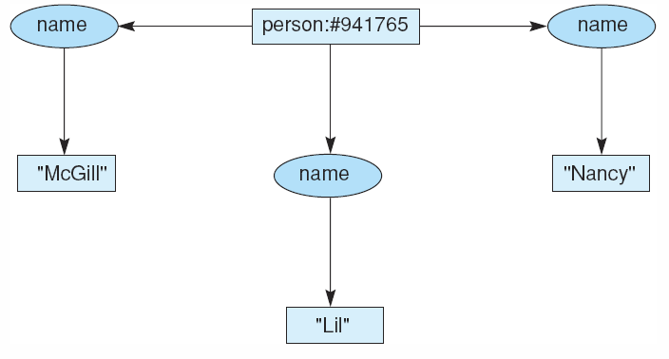
Fig 7.19 Conceptual graph of a person with three names.
Luger: Artificial Intelligence, 6th edition. © Pearson Education Limited, 2009

Slide 19
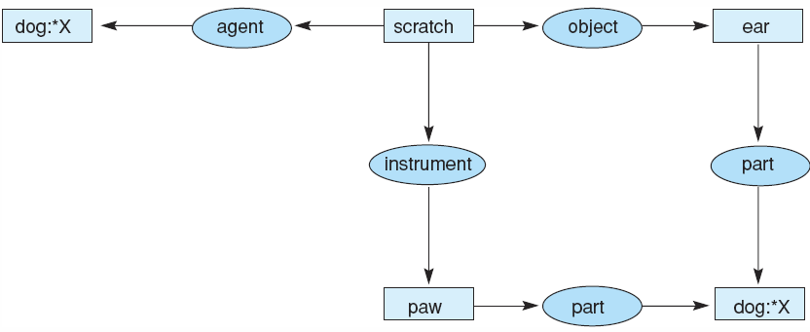
Fig 7.20 Conceptual graph of the sentence “The dog scratches its ear with its paw.”
Luger: Artificial Intelligence, 6th edition. © Pearson Education Limited, 2009

Slide 20
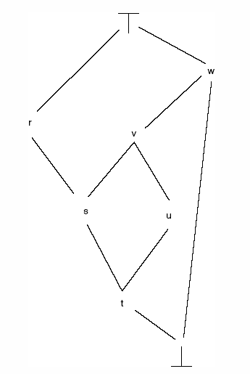
Fig 7.21 A type lattice illustrating subtypes, supertypes, the universal type, and the absurd type. Arcs represent the relationship.
Luger: Artificial Intelligence, 6th edition. © Pearson Education Limited, 2009

Slide 21
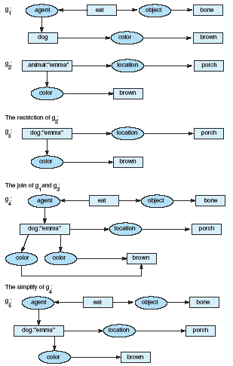
Fig 7.22 Examples of restrict, join, and simplify operations.
Luger: Artificial Intelligence, 6th edition. © Pearson Education Limited, 2009

Slide 22
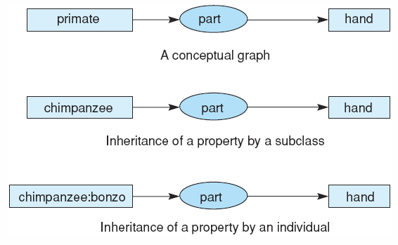
Fig 7.23 Inheritance in conceptual graphs.
Luger: Artificial Intelligence, 6th edition. © Pearson Education Limited, 2009

Slide 23
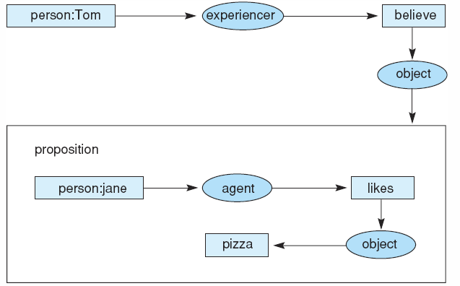
Fig 7.24 Conceptual graph of the statement “Tom believes that Jane likes pizza,” showing the use of a propositional concept.
Luger: Artificial Intelligence, 6th edition. © Pearson Education Limited, 2009

Slide 24
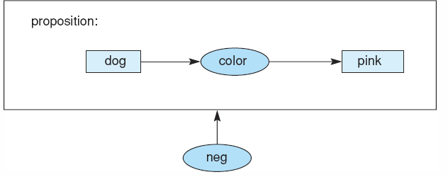
Fig 7.25 Conceptual graph of the proposition “There are no pink dogs.”
Luger: Artificial Intelligence, 6th edition. © Pearson Education Limited, 2009

Slide 25
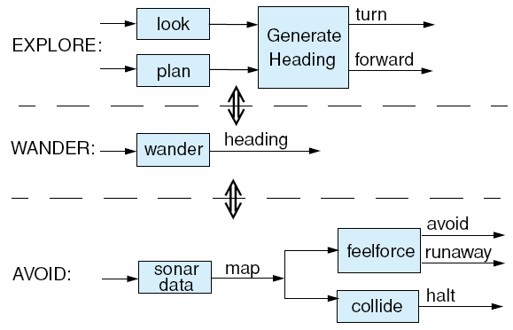
Fig 7.26 The functions of the three-layered subsumption architecture from Brooks (1991a). The layers are described by the AVOID, WANDER, and EXPLORE behaviours.
Luger: Artificial Intelligence, 6th edition. © Pearson Education Limited, 2009

Slide 26
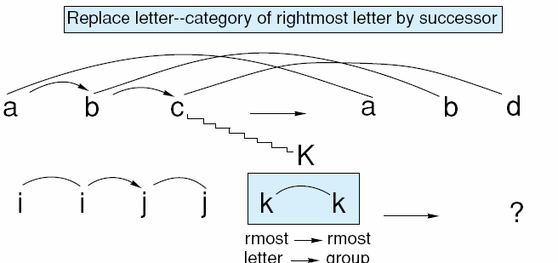
Fig 7.27 A possible state of the copycat workspace. Several examples of bonds and links between the letters are shown; adapted from Mitchell (1993).
Luger: Artificial Intelligence, 6th edition. © Pearson Education Limited, 2009

Slide 27
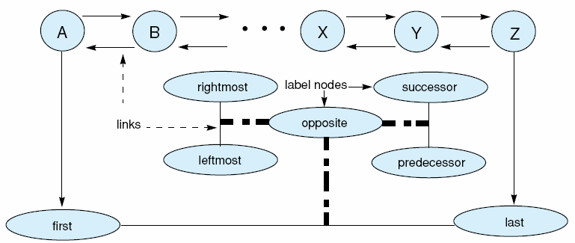
Fig 7.28 A small part of copycat’s slipnet with nodes, links, and label nodes shown; adapted from Mitchell (1993).
Luger: Artificial Intelligence, 6th edition. © Pearson Education Limited, 2009

Slide 28
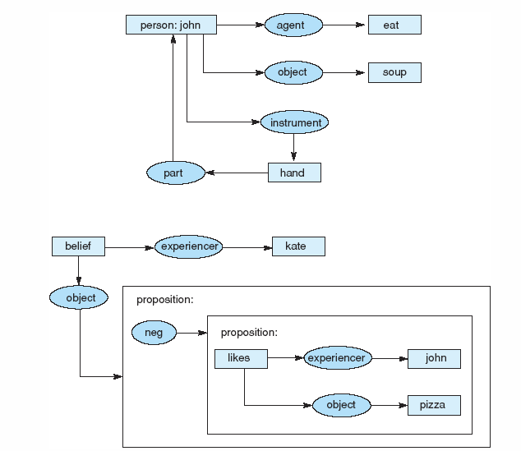
Fig 7.29 Two conceptual graphs to be translated into English.
Luger: Artificial Intelligence, 6th edition. © Pearson Education Limited, 2009

Slide 29
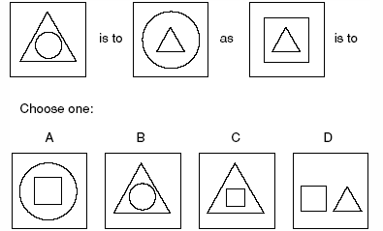
Fig 7.30 Example of analogy test problem.
Luger: Artificial Intelligence, 6th edition. © Pearson Education Limited, 2009

